Slide 1
WE DON’T TALK ABOUT GRADING
LAURA BOYLE, ED.D
Lboyle@jths.org
Lb58@email.sc.edu

Slide 2
EQUITABLE GRADING
  Quick overview of grading over the years
  What information should grades give us?
  Why are changes to grading important?
  Possible shifts to be more equitable
  What have my students said about this?
WHAT IT IS AND WHY IT’S IMPORTANT

Slide 3
Grading practices have changed very little the last 100 years. Grades were originally used by schools to sort students for future employment in industrial settings. Student grades and how those grades are communicated to students and their families often still reflect the practices from the beginning of the 20th century (Townsley & Buckmiller, 2020).
Many common grading practices emphasize the importance of accumulating points over learning and other common practices rely on awarding points for compliance.
HISTORY OF GRADING
BRIEF OVERVIEW

Slide 4

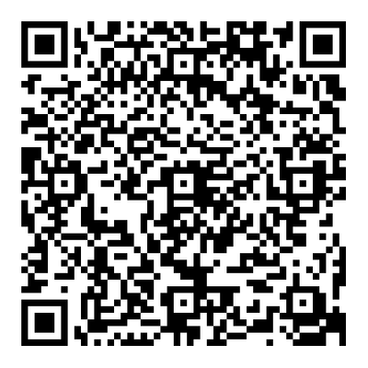
WHAT INFORMATION DO YOU THINK GRADES SHOULD ACTUALLY PROVIDE?
USE THE QR CODE TO JOT DOWN SOME IDEAS
Notes:
https://jamboard.google.com/d/1ldrb8xZ7bjR_EY68jfB1ehzR8KI9ULzdpVKE4i-T7bc/edit?usp=sharing

Slide 5
WHAT STUDENTS KNOW
Inform students how they are progressing with the learning outcomes for the class.
Do students know what they need to know to be successful?
WHAT SHOULD GRADES TELL US?
WHAT STUDENTS CAN DO
STUDENT KNOWLDEDGE AND SKILLS
Inform students how they are progressing with skill acquisition for the class.
Can students do what they need to do to be successful?

Slide 6
HS-LS2-6. Evaluate the claims, evidence, and reasoning that the complex interactions in ecosystems maintain relatively consistent numbers and types of organisms in stable conditions, but changing conditions may result in a new ecosystem.
EXAMPLE
Grades for this standard should demonstrate if students:
  can describe interactions in an ecosystem: predation, competition, mutualism, commensalism, parasitism
(What students KNOW)
  can engage in arguments from evidence: read about an example ecosystem and determine how and why that ecosystem may change based on the described change in conditions
(What students CAN DO)
NGSS HIGH SCHOOL LIFE SCIENCE

Slide 7
WHY MAKE CHANGES TO GRADING PRACTICES?
REDUCE IMPLICIT BIAS
INCREASE CULTURAL RELEVANCE
SUPPORT STUDENTS
Removing grading cateogries like effort, participation, behavior, and attendance can reduce subjectivity of grades.
Maintains the focus on each student reaching academic success through mastery and removes the idea of “points”.
Removes barriers from students that struggle outside of school and provides a supportive environment for academic and social-emotional learning.

Slide 8
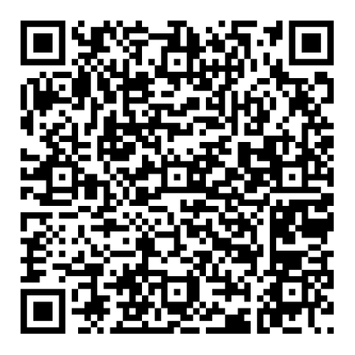
DO ANY OF THE POINTS ON THE PREVIOUS SLIDE RESONATE WITH YOU?
USE THE QR CODE TO SHARE YOUR THOUGHTS.
Notes:
https://jamboard.google.com/d/1Pke9wMU-3xEhYn1UC-VNfo5nUtluJWfzaYk5ijTBdHw/edit?usp=sharing

Slide 9
WAYS TO MAKE GRADES MORE EQUITABLE
1.
2.
3.
Standards-based learning objectives are provided each day to inform students of the expectations for class and the criteria for success (Guskey & Jung, 2009; Shippy et al., 2013).
Smaller formative assessments are given each time a standards-based objective is completed; some take a day, some take a few days to cover (Butler & Nisan, 1986).
A unit tracker is provided at the end of each unit for students to record their summative assessments, their mastery score on each, and determine their retake needs (Feldman, 2019; Iamarino, 2014).

Slide 10
CONT.
4.
5.
Plan ahead for one retake day for each unit assessment to occur during class time after students receive their retake practice work (Feldman, 2019; Iamarino, 2014).
Do not assign homework. Instead, courses are structured so that students have time during the class period to complete the necessary work (Feldman, 2019).
6.
7.
Ungraded formative assessments are given to students prior to summative assessments. These formative assessments are only used to provide students with feedback on their learning (Iamarino, 2014).
Students are given rubrics for all summative projects and labs (Feldman, 2019).

Slide 11
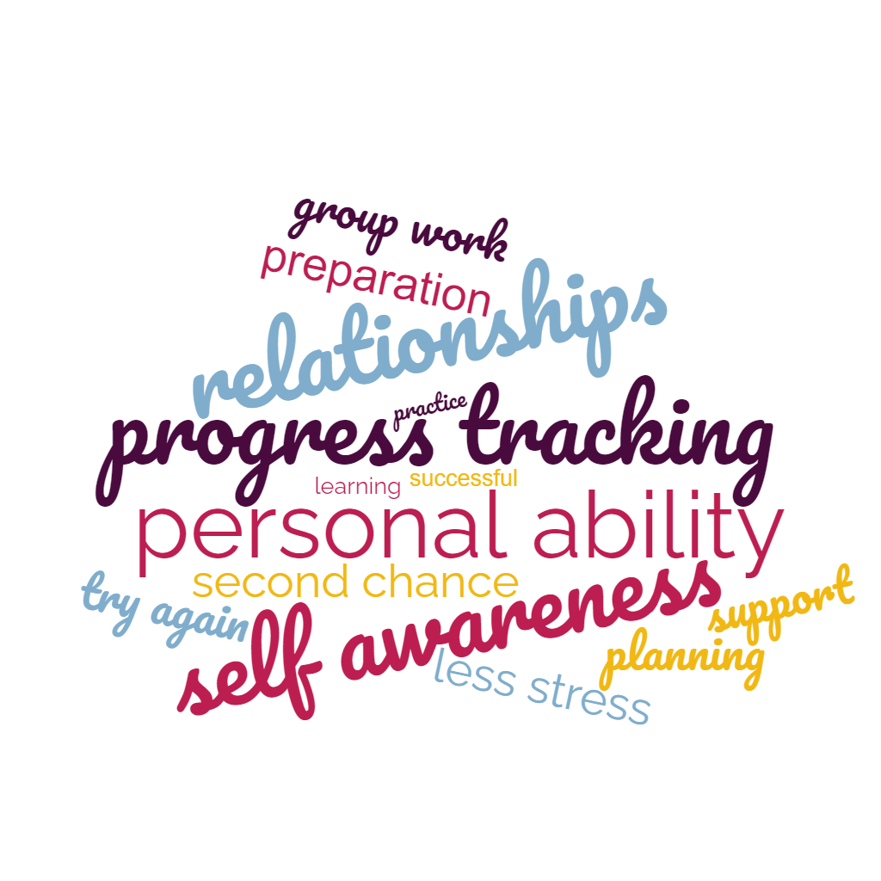
HOW HAVE THESE CHANGES HELPED?

Slide 12

HS-LS2-6. Evaluate the claims, evidence, and reasoning that the complex interactions in ecosystems maintain relatively consistent numbers and types of organisms in stable conditions, but changing conditions may result in a new ecosystem.
EXAMPLE
Grades for this standard should demonstrate if students:
  can describe interactions in an ecosystem: predation, competition, mutualism, commensalism, parasitism
(What students KNOW)
  can engage in arguments from evidence: read about an example ecosystem and determine how and why that ecosystem may change based on the described change in conditions
(What students CAN DO)
NGSS HIGH SCHOOL LIFE SCIENCE

Slide 13
CHALLENGES
THE THREE BIGGEST CHALLENGES I FACED...
Challenge 1
Challenge 2
Challenge 3
Losing “points” as a behavior management strategy and having to rely more on relationships built with students to hold students accountable for their behavior and decisions.
Shifting away from compliance and focusing on the importance of mastery. Realizing not all students need the same amount of practice and giving more practice than what is needed is just busy work.
The time to implement change, along with the change in timing of events with retakes, practice work, and progress tracking changes how we plan our time.

Slide 14
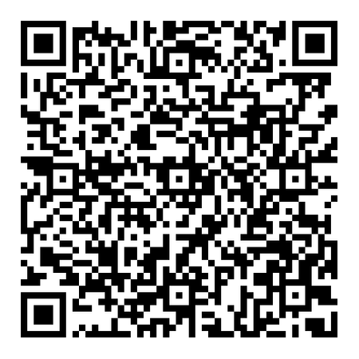
WHAT CONCERNS WOULD YOU HAVE IF YOU WERE MAKING A CHANGE IN YOUR GRADING PRACTICES?
USE THE QR CODE TO SHARE YOUR THOUGHTS.
Notes:
https://jamboard.google.com/d/1Kj200BEGJBzxd5DJ7Tz85tq3QzzrYZqymwCDbs00UXc/edit?usp=sharing

Slide 15
THANK YOU!
REFERENCES
Butler, R., & Nisan, M. (1986). Effects of no feedback, task-related comments, and grades on intrinsic motivation and performance. Journal of Educational Psychology, 78(3), 210–216. https://doi.org/10.1037/0022-0663.78.3.210
Decuir, J. T., & Dixson, A. D. (2004). “So when it comes out, they aren’t that surprised that it is there”: Using critical race theory as a tool of analysis of race and racism in education. Educational Researcher,33(5), 26-31. doi:10.3102/0013189x033005026
Feldman, J. (2019). Beyond standards-based grading: Why equity must be part of grading reform. Phi Delta Kappan, 100(8), 52-55.
Feldman, J. (2019). Grading for equity: What it is, why it matters, and how it can transform schools and classrooms. Corwin.
Guskey, T. R., & Jung, L. A. (2009). Grading and reporting in a standards-based environment: Implications for students with special needs. Theory Into Practice, 48(1), 53-62. doi:10.1080/00405840802577619
Iamarino, D. L. (2014). The benefits of standards-based grading: A critical evaluation of modern grading practices. Current Issues in Education, 17(2), 1-12
Ladson-Billings, G. (1995). Toward a theory of culturally relevant pedagogy. American Educational Research Journal, 32(3), 465–491. https://doi.org/10.3102/00028312032003465
Shippy, N., Washer, B. A., & Perrin, B. (2013). Teaching with the end in mind: The role of standards-based grading. Journal of Family & Consumer Sciences, 105(2), 14-16. doi:10.14307/jfcs105.2.5

